Slide 1
Data pipeline from Front Office to Data Lake

Slide 2










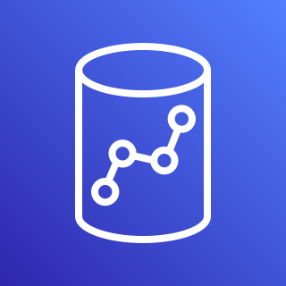

L Transformer
Athena
DynamoDB Streams
DynamoDB Audit Table
L Lnd Cleanup
1 min
Step 2
S3 bucket
(staging area)
K data stream
K delivery stream
SQS Lnd Q
L G ETL + Audit entries
G Spark ETL
1 min
Step 1
5 min
S3 bucket
(landing area)
0 min
Data Source
EB Rule
L -> Lambda
K -> Kinesis
Lnd -> Landing Area
Stg -> Staging Area
Crw -> Crawler
Trg -> Trigger
G -> Glue
EB -> EventBridge
Data Source
L Data Publisher
L Data Consumer
G Workflow
API Gateway
G Stg Crw
G Python Shell
G Spark ETL
Job bookmark
DynamoDB Data Table
Redshift
Capture Order Details (UI)

Slide 3
Notes:
In the Glue Workflow, the first job – Glue Spark ETL job – loads the Redshift staging table from S3 staging area (with Job bookmark enabled) and the second job – Glue Python Shell job – performs data enrichment and “Upsert” into the Redshift final table.
For the Glue Workflow, the Trigger is the EventBridge Rule but the data source is the S3 Staging area.
Glue Crawler is setup to run on the S3 Staging area.
So staging area is available for raw data analysis (before data enrichment) through Athena.
From “L G ETL + Audit entries”, there are 2 steps – one step to start the Glue Spark ETL job that processes data from S3 landing area to S3 staging area and another step to load the dynamodb audit table with info around the files that were processed from the landing area. This info is used to cleanup the landing area as well, through the use of DynamoDB streams and lambda function. It is important that, as Step 1 the Glue Spark ETL job is triggered and only after the completion of this job, as Step 2, the dynamodb audit table is loaded. Else, the landing area could be cleaned up before the processing into the S3 staging area, resulting in either job failure (of the Glue Spark ETL job) or data loss.

